Slide 1
Data Acquisition & Data Wrangling
Presented by:- Surabhi Patil

Slide 2
Objectives:
The objectives of this project are to do Data Acquisition and Data Wrangling on dataset 1,2, and 3
Also need to Check skewness, Correlation analysis

Slide 3
Tools and Libraries used:
Tools:
Jupyter Notebook (interactive coding environment)
Python (programming language)
Libraries:
Pandas (data manipulation and analysis)
NumPy (numerical computations
SciPy (scientific computing, specifically for Spearman rank correlation)
Matplotlib (data visualization)
Seaborn (data visualization, specifically for heatmaps and pair plots)
pingouin (partial correlation)

Slide 4
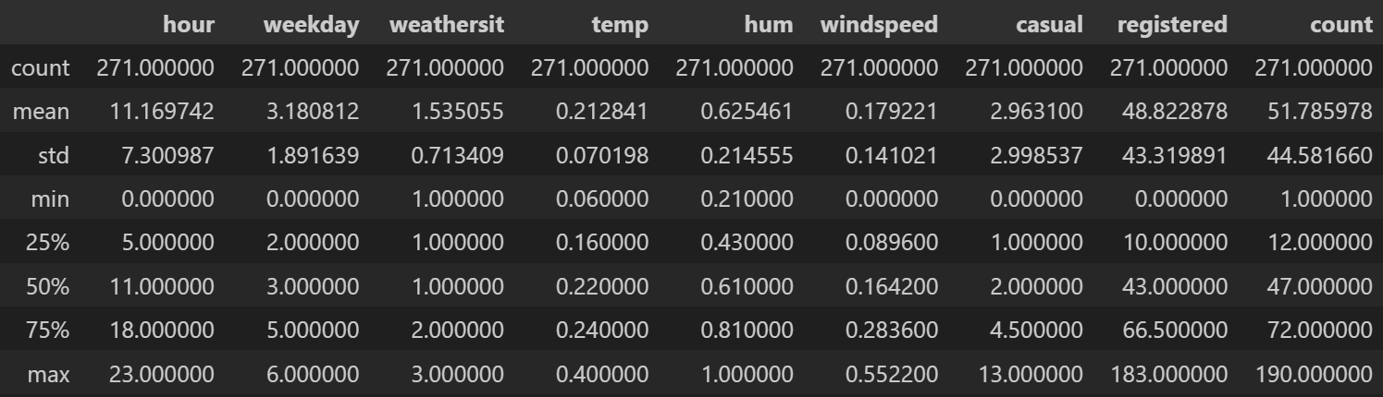
Data summary statistics:

Slide 5
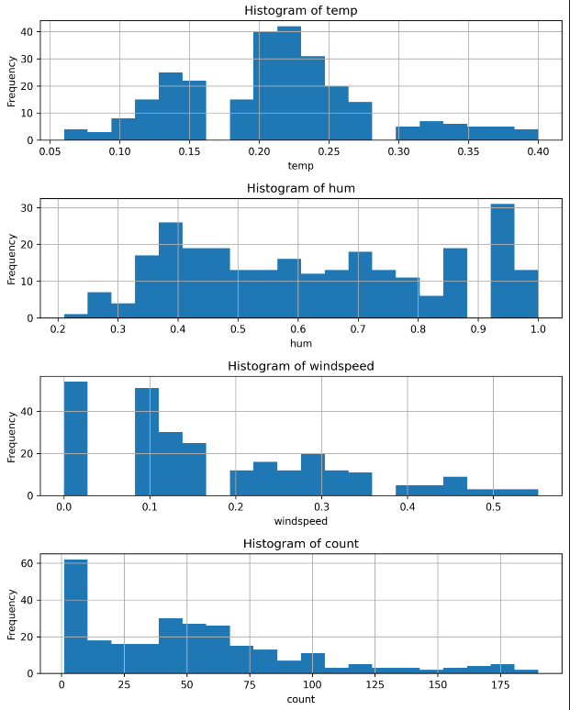
Distribution plots:

Slide 6
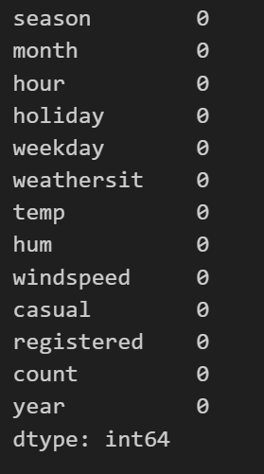
Missing Values Check:

Slide 7
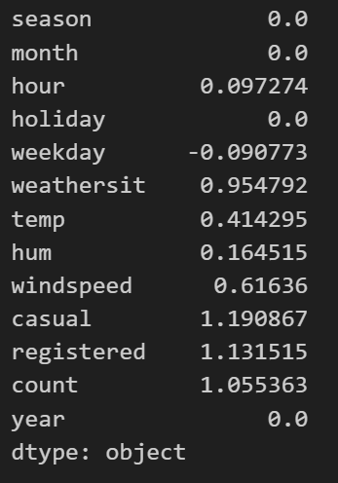
Skewness analysis:

Slide 8
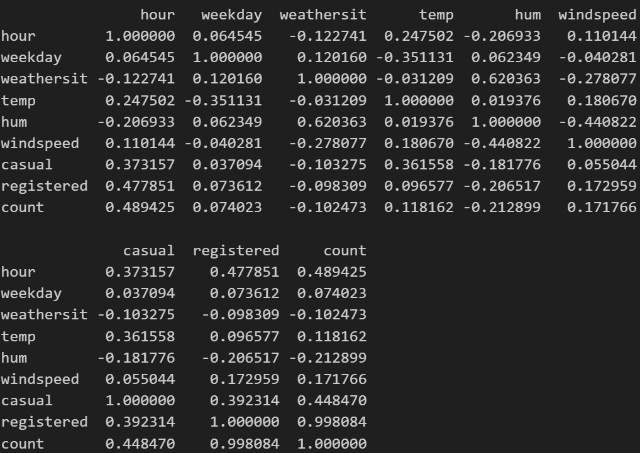
Correlation Analysis:

Slide 9
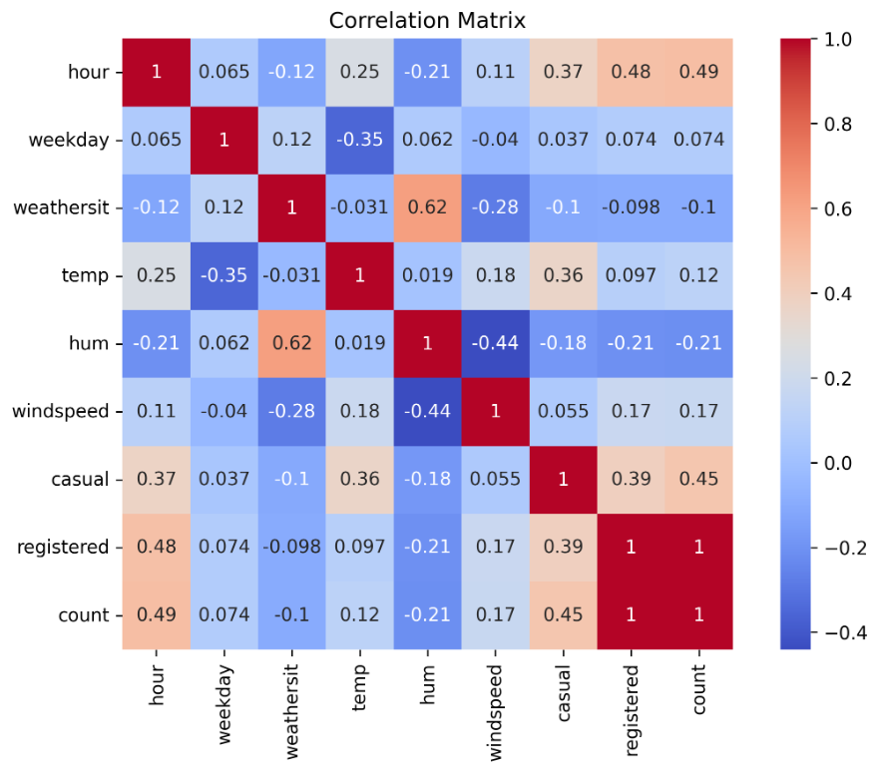
Correlation Heatmap:

Slide 10
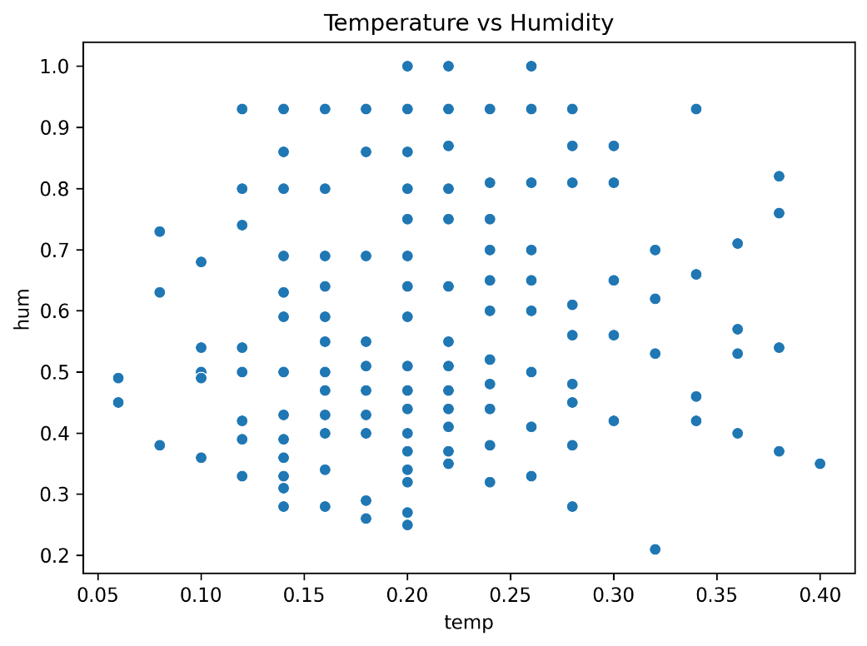
Scatter plot of Temperature vs Humidity:

Slide 11
Insights:
Strong Correlations:
Registered-Count: 0.998084 (very strong positive)
Casual-Registered: 0.392314 (moderately positive)
Casual-Count: 0.448470 (moderately positive)
Humidity-Weather Situation: 0.620363 (strongly positive)
Wind Speed-Humidity: -0.440822 (strongly negative)
Weak Correlations:
Temperature-Humidity: 0.019376 (weak positive)
Temperature-Wind Speed: 0.180670 (weak positive)
Humidity-Weekday: 0.062349 (weak positive)

Slide 12
Conclusion:
Registered users and total count are highly correlated
Casual users are moderately correlated with registered users and the total count
The hour of the day influences casual and registered users
Weather situation strongly affects humidity
Wind speed negatively impacts humidity

Slide 13


